Slide 1
Risk & Control
Matrix Generator
DTCC Hackathon – Internal Audit & Assurance

Slide 2
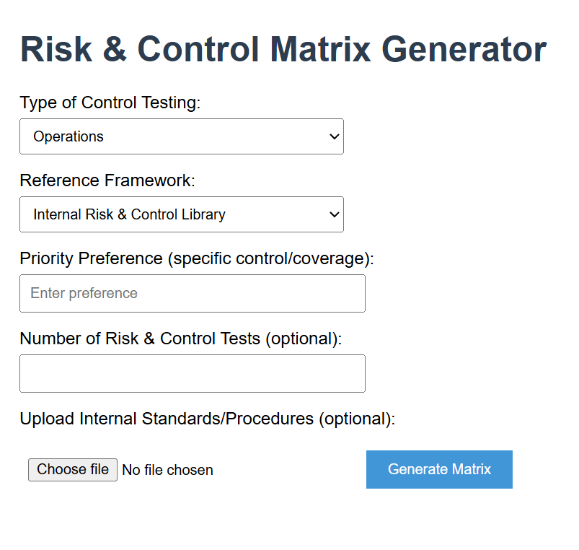
Risk & Control Matrix Generator
Problem: Manual creation of risk & control test matrices is time-consuming and inconsistent.
Solution: A simple web form powered by AI that generates tailored risk & control matrices with test steps.
Key Features:
Choose control type (Tech/Operations)
Select framework (Internal, COBIT, NIST)
Set priority preferences
Optional: number of tests & upload internal standards
Impact: Saves time, ensures consistency, aligns with frameworks.

